Slide 1
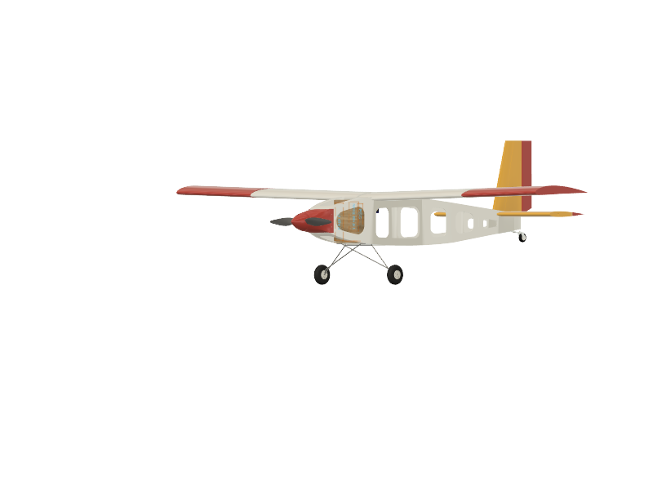

MJ⁵ Presents:
Col. Pollo J. Rosso
Mark Gabriel Samac, Jeffrey Denenberg, Jeff Bratman, Johnpierre Khachi, Justin Rector, Joseph Tuazon

Slide 2
Sizing Changes
Notes:
done

Slide 3
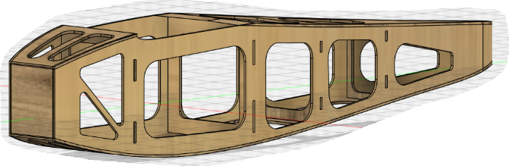
Objective to make a curved fuselage remains, prioritizing payload weight for practicality
Jeffrey D.
The payload volume drop-off mechanism is located behind the wing; weight mounts are placed right below
We focused on maximizing the weights carried, the key factor influencing our flight score
Minimum Weight of 0.5 lb | Minimum Volume of 500 cm³
Final Weight of 1.5 lb | Final Volume of 700 cm³
Payload Parameters
Initial Fuselage Design

Slide 4
Initial sizing estimates became foundations, with slightly increased final gross weight
Jeffrey D.
Initial Sizing Estimates
Wing loading:
~2 lb/ft², 100 N/m²
Wing area: ~0.27 m²
Cruise speed: ~20 m/s
Thrust-to-weight: ~0.8
Empty weight: ~1.32 kg
Gross weight: ~2 kg
Final Sizing Parameters
Wing loading:
1.6 lb/ft², 77 N/m²
Wing area: 0.27 m²
Cruise speed: ~15-19 m/s
Thrust-to-weight: ~0.8
Empty Weight: 1.4 kg
Gross weight: 2.125 kg

Slide 5
Propulsion and Performance

Slide 6
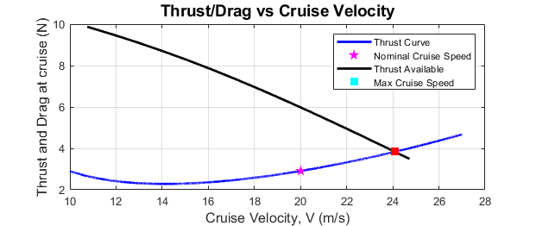
At steady-level flight, the 9x6E propeller is still in use to meet the 3N minimum thrust
Jeff B.
At 9000 RPM, the chosen propeller generates 3.75 N of thrust, enough to maintain nominal cruising speed
The RPM range of 6500 - 10500 allows room to increase aircraft speed
Notes:
done

Slide 7
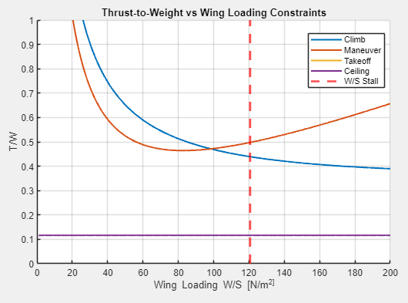
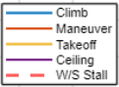
Agile performance at Climb and Maneuver
Jeff B.
Main Parameters/Conditions | Value
n (Load Factor) | 4
𝜸 (Climb Angle) | 15 deg
Stall Speed | 10 m/s
Wing loading | 77 N/m²
μ (Runway) | 0.03
T/W | 0.55
Takeoff Distance | 14.7 m
Notes:
done

Slide 8
Aerodynamics

Slide 9
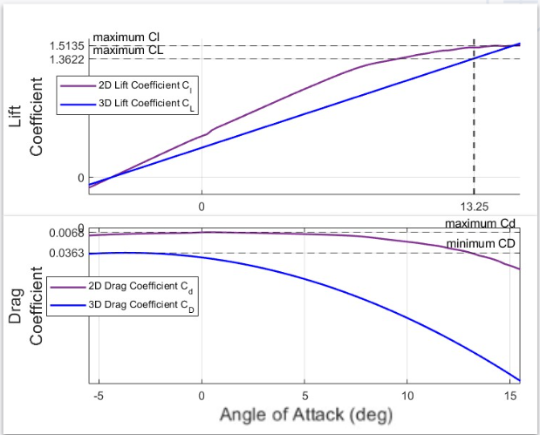
NACA 4412 aerodynamic data still in use, Re = 500,000 (XFOIL)
Mark S.
We reinforced the wing by adding 3mm balsa ribs at wing tips
The 3D aerodynamics results are assumed the same for the final aircraft, with a target angle-of-attack of 13.25°

Slide 10
Modifying the taildragger landing gear will let us maximize takeoff performance
Mark S.
Major Aerodynamic Parameters & Values |  |  | Main Wing Dimensions
CL,max | 1.3622 |  | Planform Area | 0.27 m²
CD,min | 0.0363 |  | Wing Span | 1.35 m
(L/D),max | 35.838 |  | Chord | 0.2 m
S_{wet}/S_{ref} | 2.0480 |  | Aspect Ratio | 6.75
AOA (max L/D) | 13.25° |  | Sweep | 0
CD₀ | 0.035 |  | Taper Ratio | 1

Slide 11
Weights and Stability
Notes:
done

Slide 12
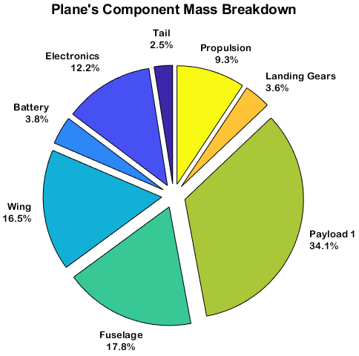
We expected the final gross weight to be slightly higher than targeted
Justin R.
As mentioned before, our final gross weight, 2.125 kg, is higher than previous estimate, 2 kg
Empty weight increased by 125 grams as of now
Relatively Same Mass Breakdown as predicted

Slide 13
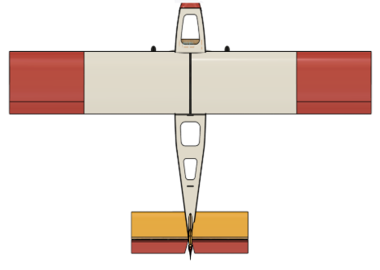
Tail Sizing changes since previous estimates
Justin R.
Changes in Planform Area (in % of Wing)
Horizontal Stabilizer
Previous | Final
16 | 19
Vertical Stabilizer
Previous | Final
13 | 11
Aircraft Top View

Slide 14
The aircraft is still expected to be stable in all 3 configurations with slight variations
Justin R.
Very stable flight due to static margin
CG is was slightly forward but it might be pushed back within ⅓ leading Edge
Actual CG location to be remeasured but preliminary measurements show its on par with previous calculations
Parameter | % from MAC
Neutral Point | 58
CG (Empty Flight) | 24.73
CG (with Payloads 1 & 2) | 24.05
CG (with Payload 1) | 23.97
Static Margin | 17%

Slide 15
Fabrication Design

Slide 16

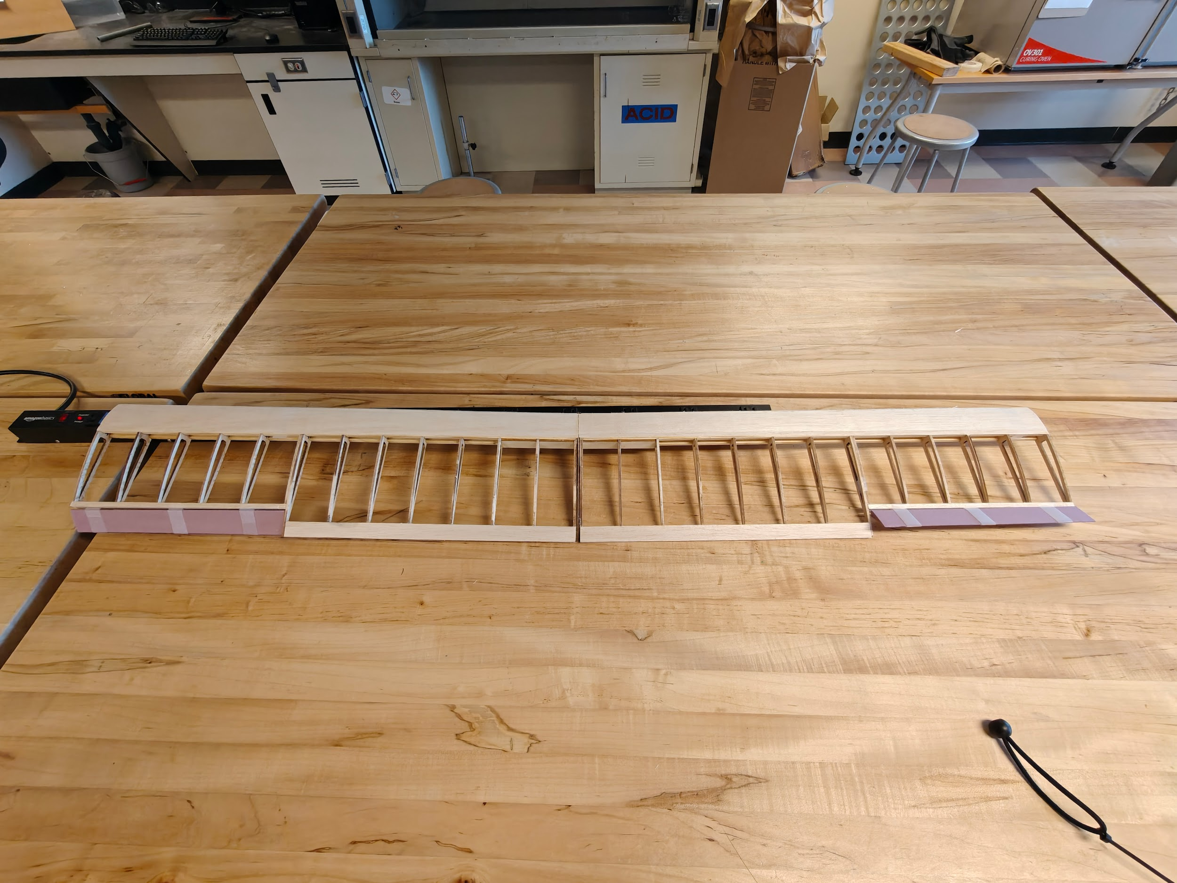
The wing a lightweight but strong wing structure with dihedral configuration
Johnpierre K.
It is built mainly from balsa (ribs, shear webs, skin); semi-monocoque design applied to the leading edge
Main spars made from dowel wood, which is stronger than balsa
3° dihedral angle, created using two interlocking plywood plates integrated into ribs and spars, overall improves roll stability
A wing-fuselage reinforced plywood connection at the center allows better load transfer
Ailerons span 60–100% from root with height of 20% of wing chord
Notes:
done

Slide 17
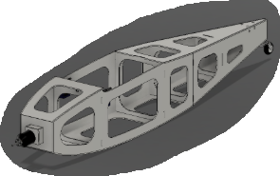
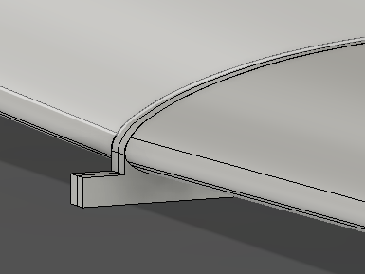
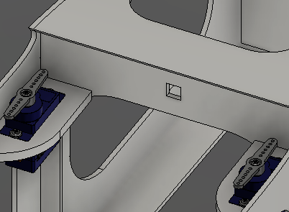
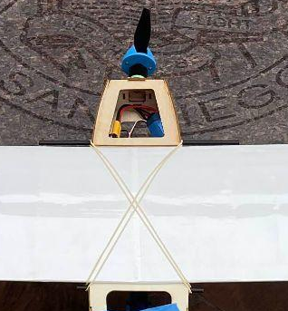
An aerodynamically shaped fuselage helps reduce drag; wing is easily attached/removed
Johnpierre K.
2mm plywood
Wing slides into a cutout slot in the fuselage and attached together with rubber bands (at 2 carbon tubes)
The slot transfers wing loading efficiently from the wing to the fuselage
Reinforced structure at firewall and landing gear attachment points for impact resistance and torque loads
Wing-to-fuselage mounting

Slide 18
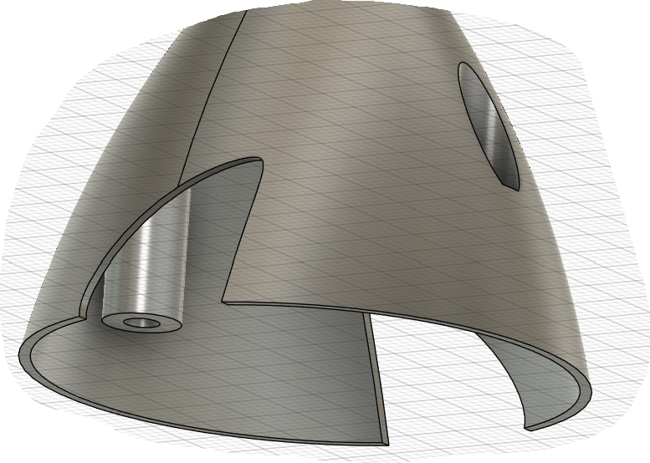
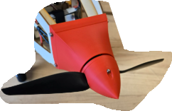
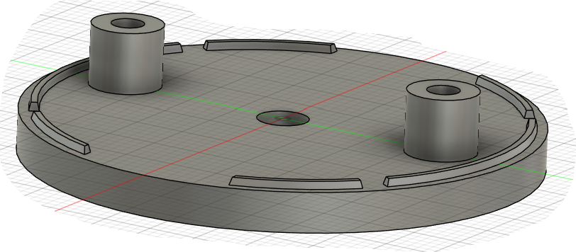
A 3D-printed nose cone and motor cover were added to ensure continuous airflow
Mark S.
The nose cone consists of a cover and a spinner, attached together with screws (exact length) and nuts
Bumps were added to the washer to hold the nose cone in place
Clearances accounted for both nose cone propeller holes and the gap from the motor cover
Final Nose Cone and Motor Cover (attached w/ screws)
Nose Cone Design

Slide 19
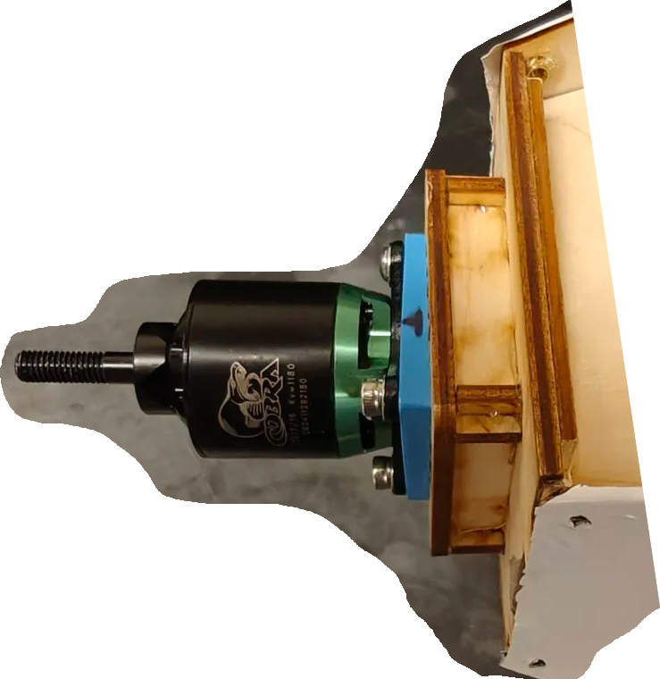
A mount displaces the motor forward
and places it 2° right & 3° down
Joseph T.
A mount fabricated with 3mm plywood displaces the motor by 15 mm forward from the firewall
Interlocking wood panel joints glued with epoxy
A 3D-printed (PLA) mount shim is added to achieve a 2° to the right and 3° down angle, counteracting the corkscrew effect of single propeller
Final Motor Mount
Notes:
done

Slide 20
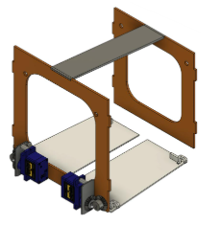
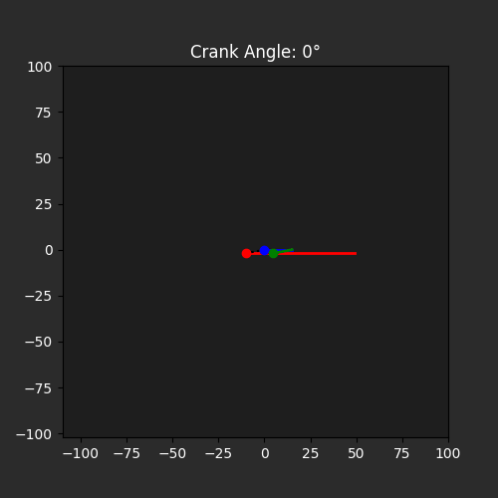
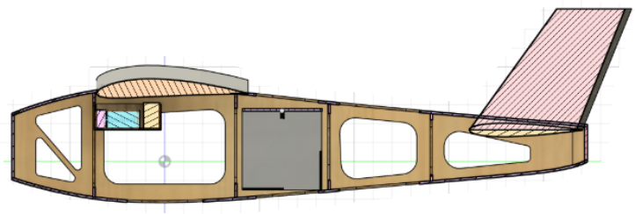
Package drop-off mechanism settings guarantee a simple and smooth mission
Jeff B.
A 4-bar linkage design to allow full 90° opening
Dual servo drive, with one servo controlling each door
Retaining guides added to door to retain package
Return springs will assist doors to return to fully closed position
Mechanism Design & Package Location View
Door Movement
Notes:
done

Slide 21
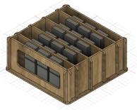
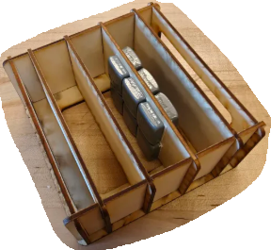
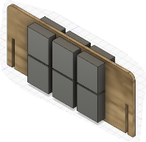
Removable slides in the mount allows easy payload weight adjustment
Joseph T.
Fabricated with 2mm thick plywood, the weight payload mount has four slides
One slide can accommodate up to eight 1/2 oz weights per side, an overall maximum of 2 lbs
It is secured in the fuselage with velcro which also allows positional adjustment with respect to aircraft CG if necessary
Final Design
Concept Design
Notes:
done

Slide 22
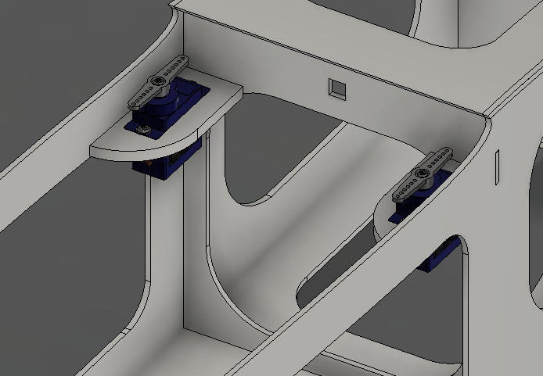
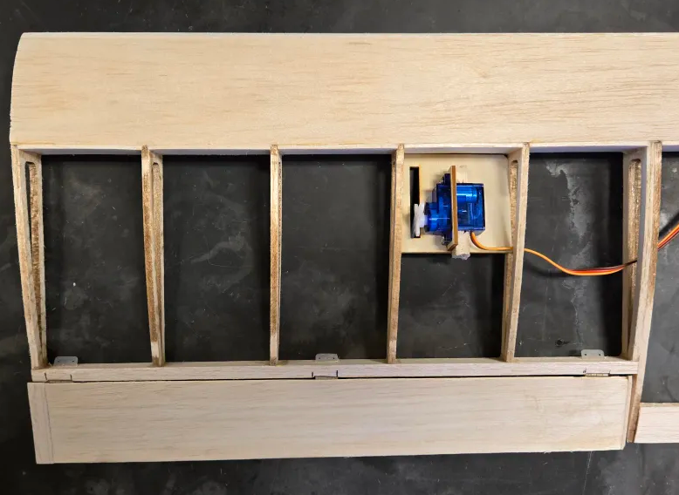
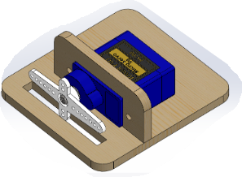
Control system attachments screwed inside; electronics can be repositioned with velcros
Jeffrey D.
Control surfaces connected to servo motors through push-pull rods (inside plastic tubes)
Servo travel of +/- 30° provides ample control for all maneuvers
Servos controlling ailerons located inside the wing
All electronics mainly in front of the wing, maintained in place with velcro
Servo mount for elevator and rudder

Slide 23
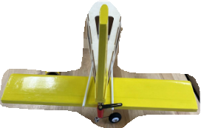
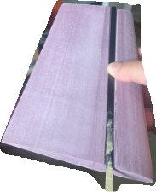
Empennage (Tails) fabrication and attachment of control surfaces
Justin R.
Back View of Empennage
The tails have foam as core, coated with balsa and monokote as skin
Carbon fiber spars at MAC location for both Vertical and Horizontal Tails
¼” balsa supports for control surfaces, attached individually using 4 nylon pin hinges
+/- 30 and +/- 20 Beveled Clearance on Elevator/Rudder
Vertical Stabilizer Foam Core and Spar Attachment
Notes:
done

Slide 24
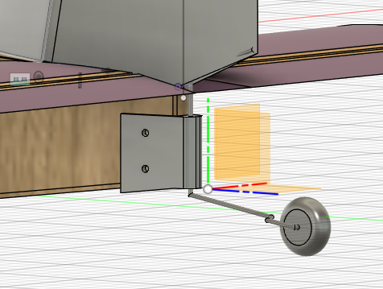
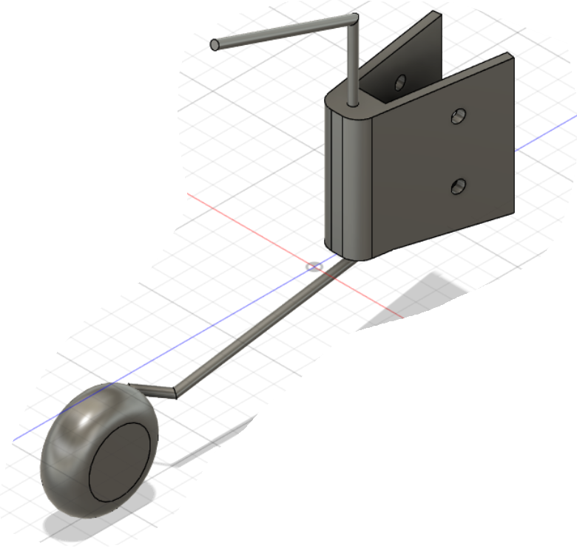
The modified landing gear allows takeoff angle of 10.8°, with room to reach maximum L/D
Joseph T.
The front landing gear, attached with 2 screws to the fuselage, and the rear wheel attachment were bent to achieve higher takeoff angle.
3D-printed (PLA) part aligns rear wheel pivot point with rudder hinge to prevent seizing
Our current takeoff AoA is 10.8°, but we plan to reach 11-13°
Notes:
done

Slide 25
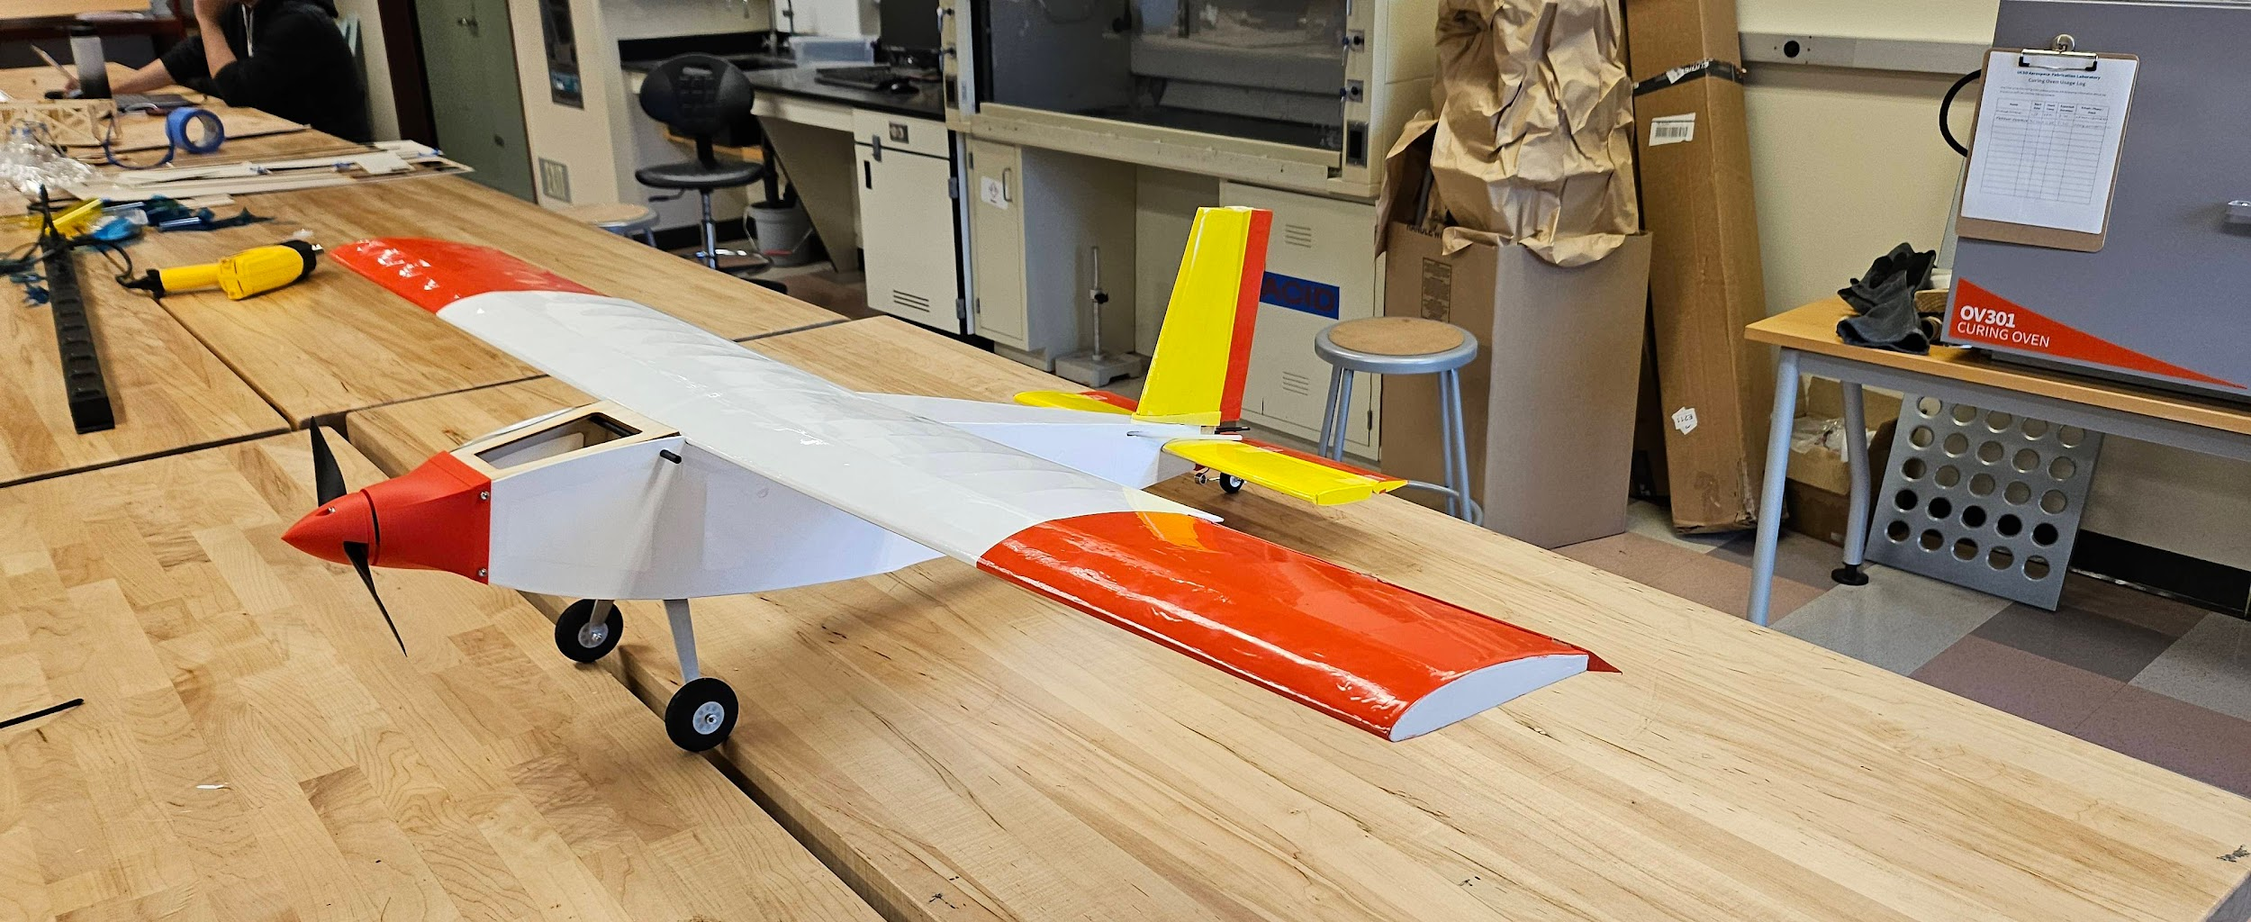
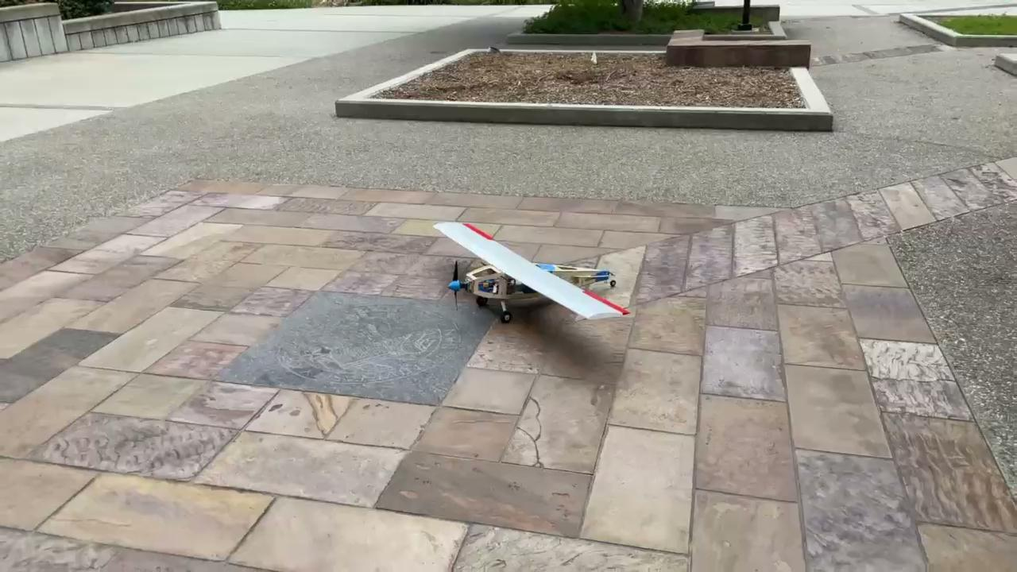
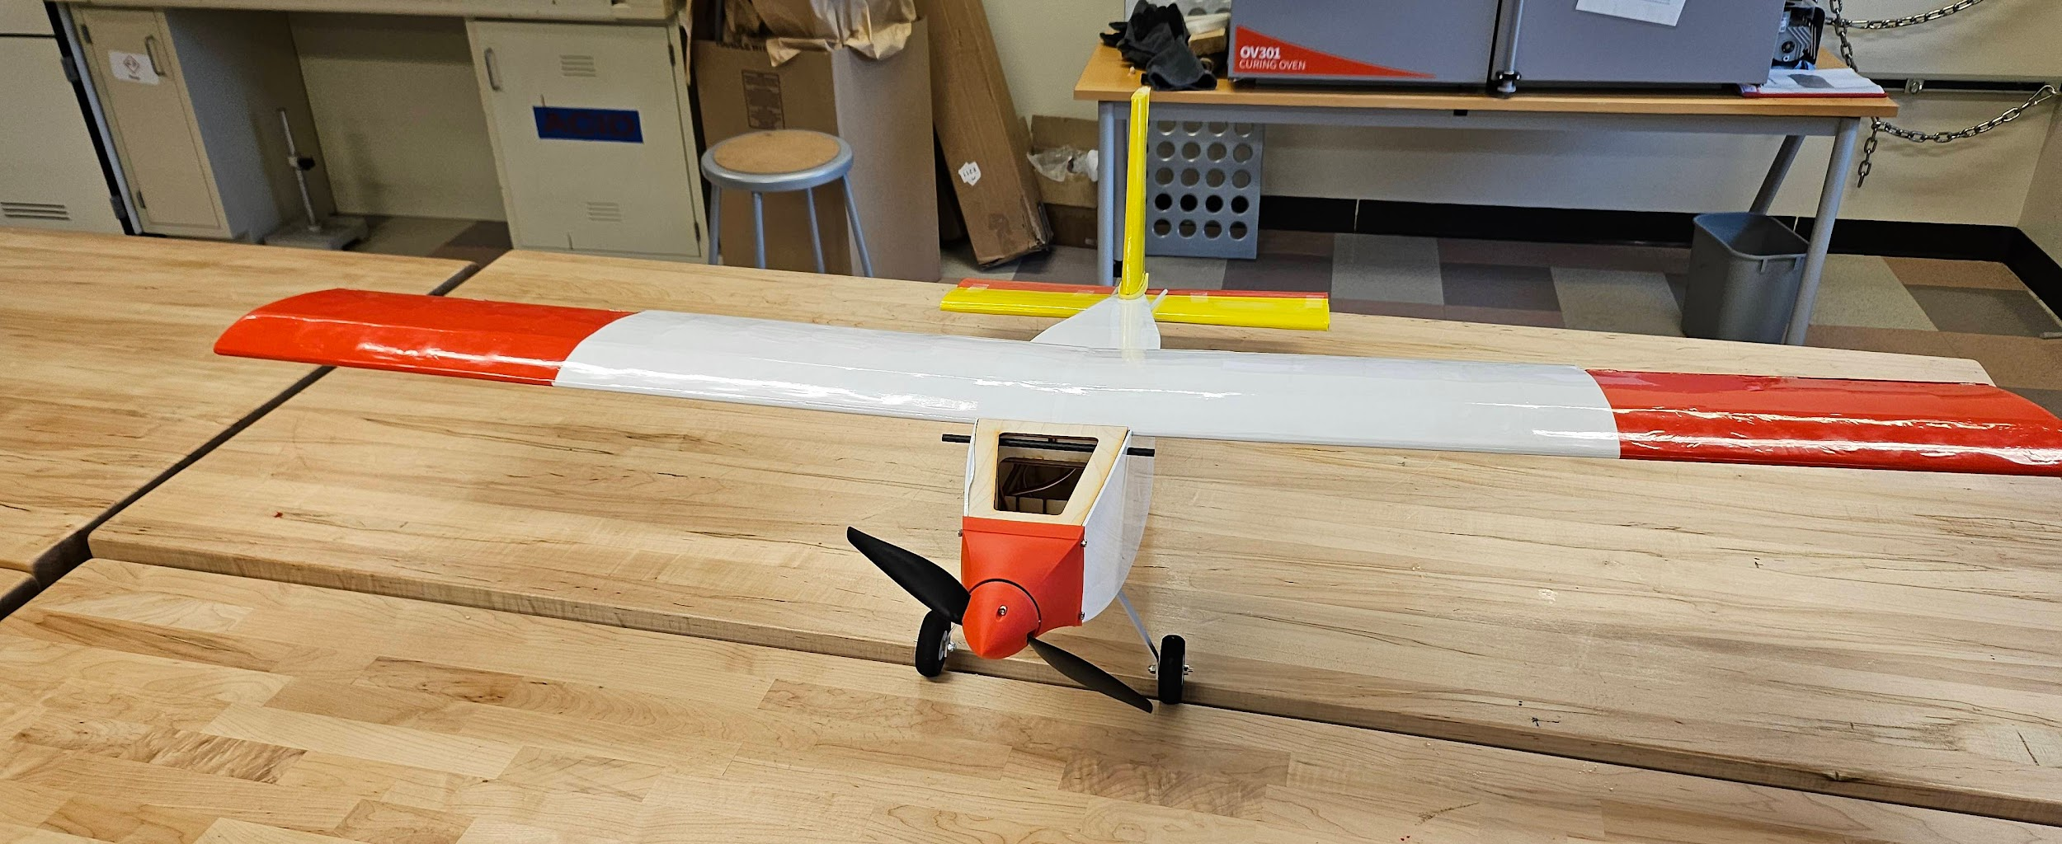
Our flight test is scheduled tomorrow, where pilot feedback will update our design if needed
Jeffrey D.

Slide 26
References
[1] - Raymer, Daniel P. Aircraft Design: A Conceptual Approach: A Conceptual Approach. 6th ed., American Institute of Aeronautics and Astronautics Inc, 2018.
[2] - https://www.airliners.net/photo/Stick-n-Rudder/Aeropro-Eurofox-
2K-Taildragger/6372355
[3] - Hwang. J. Lecture 01 - Introduction. MAE 155B. University of California San Diego
[4] - https://en.wikipedia.org/wiki/P-factor

Slide 27
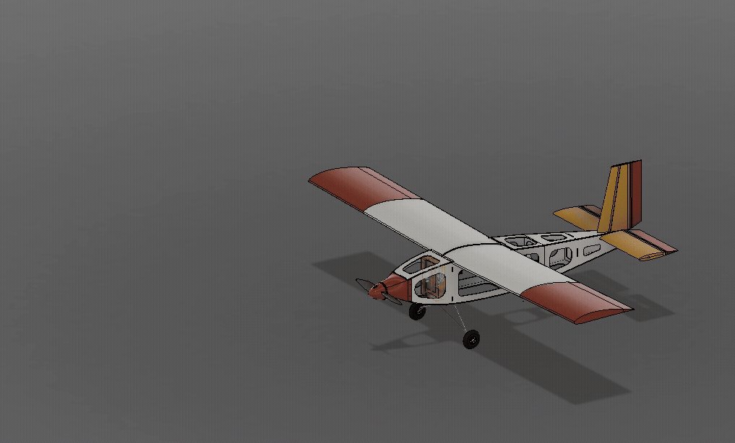
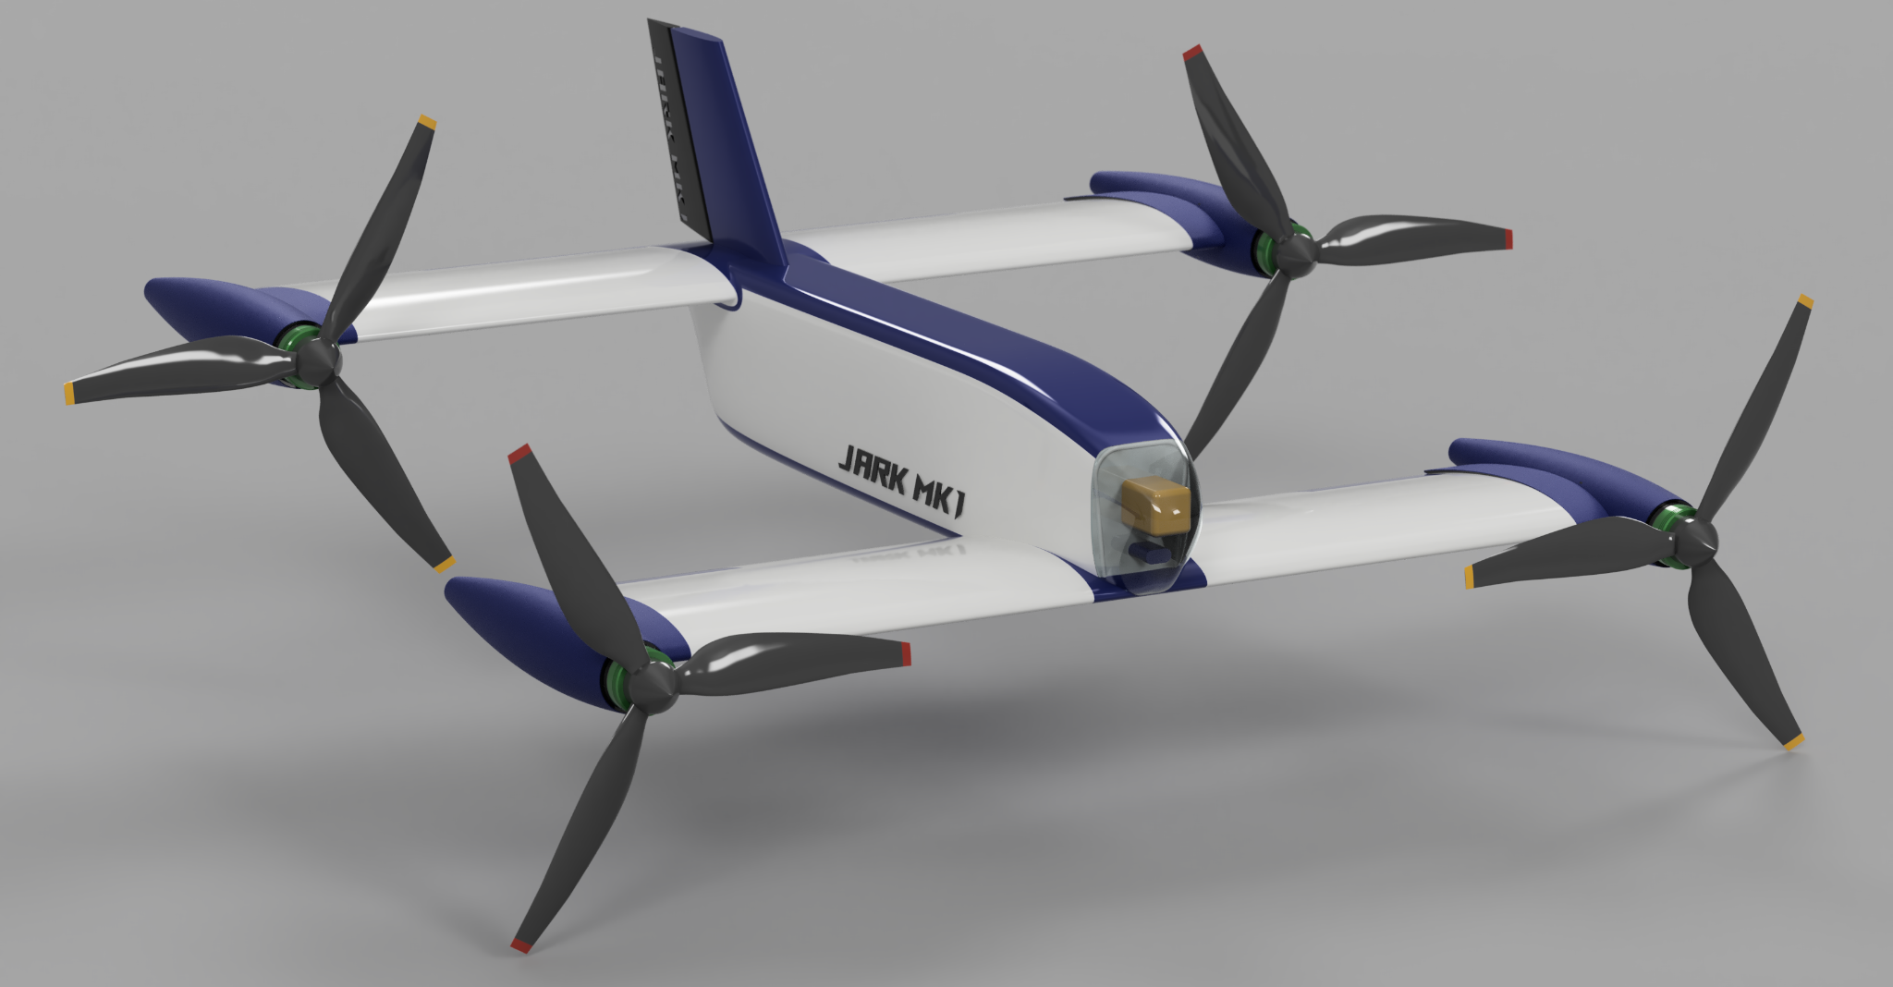
Thank you!

